Slide 1


Slide 2
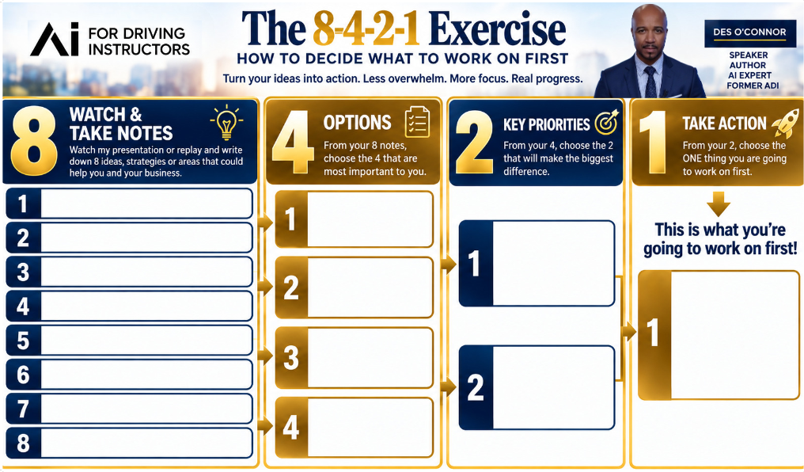

Slide 3
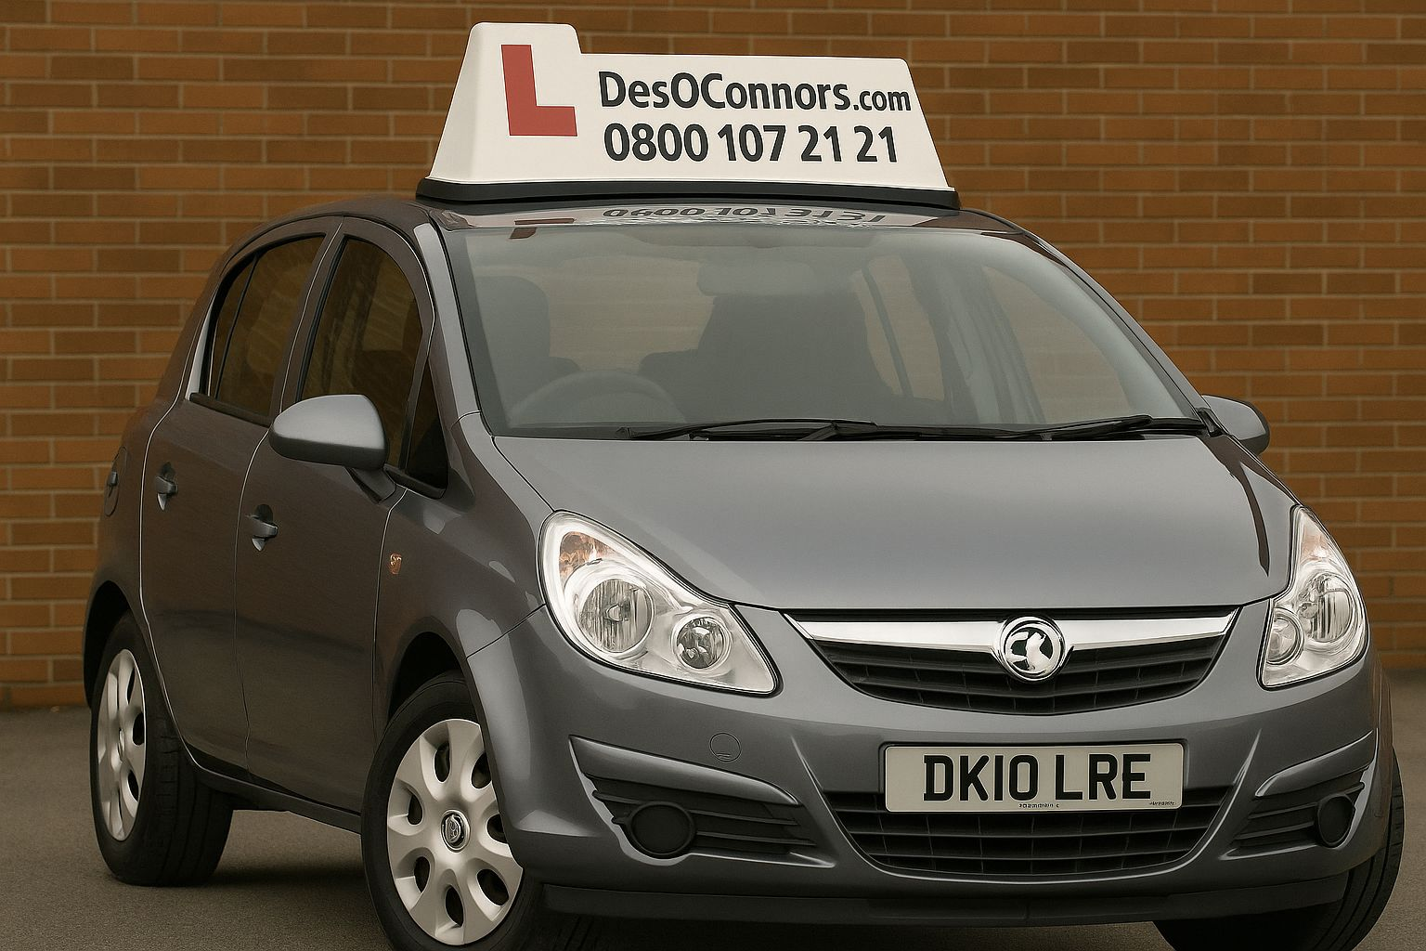

Slide 4


Slide 5

Why AI Matters Now
AI Isn’t Coming. It’s Already Here.
Save time
Work smarter
Generate better ideas
Improve your marketing
Stay competitive

Slide 6
“AI Will Not Replace Driving Instructors.
Driving Instructors Who Use AI May Replace Those Who Don’t.”

Slide 7
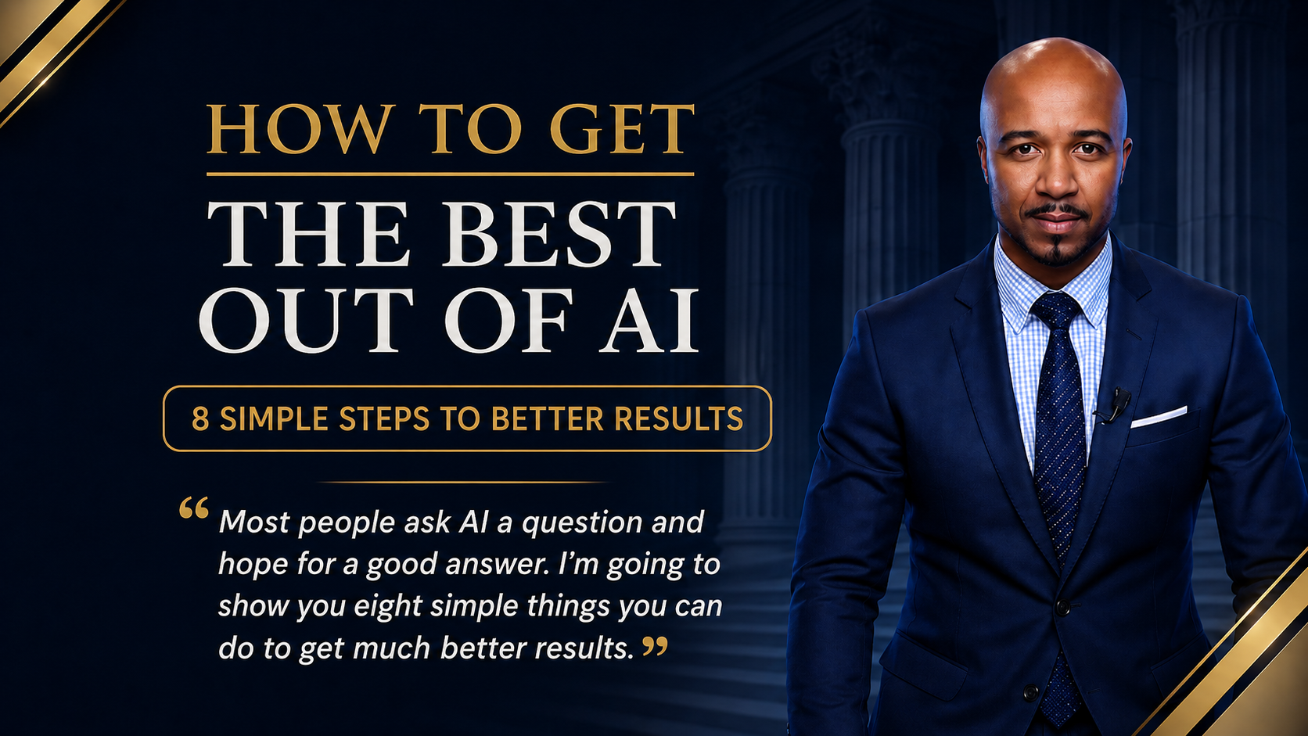

Slide 8
1
GIVE AI DIRECTION
Set the Right Perspective
ROLE | EXPERTISE | SPECIALISM
“Act as an experienced marketing strategist specialising in…”

Slide 9
2
GIVE AI CONTEXT
Tell AI What It Needs to Know
WHO | SITUATION | AUDIENCE | PROBLEM
Give AI the relevant background, challenges and what's been tried.
Right Context. Better Results.

Slide 10

DEFINE THE OBJECTIVE
Tell AI What Success Looks Like
3
“Give me ideas to grow my business.”
“Help me generate 10 additional enquiries
per week.”
Be specific about the outcome.

Slide 11
4
GET AI TO INTERVIEW YOU
Don't Let AI Guess
“Before answering, interview me.”
“Ask me 5–7 questions to understand my situation.”
Better Questions → Better Context → Better Results

Slide 12
Don’t just prompt AI.
Challenge AI.
5
DEFINE THE OUTPUT
Tell AI What You Want Back
“Give me your 5 strongest recommendations…”
“…then create a simple 30-day action plan.”
FORMAT | LENGTH | DETAIL | PRIORITY

Slide 13
SET THE CONSTRAINTS
Tell AI the Boundaries
6
“Keep this within my £xxx monthly budget.”
“Only recommend actions I can implement within 30 days.”
TIME | BUDGET | RESOURCES | MUST / MUST NOT

Slide 14
CRITIQUE x100
Challenge the Answer
7
“Critique this x100. Be extremely critical.”
“Now produce a significantly stronger version.”
WEAK | GENERIC | MISSING | UNREALISTIC | ASSUMED

Slide 15

DEEP RESEARCH
Don't Just Ask. Investigate.
8
“Deep research this using credible, current sources.”
Findings + Recommendations + Citations
EVIDENCE | CONFLICTS | GAPS | SOURCES

Slide 16
BETTER INPUT. BETTER THINKING. BETTER RESULTS.
“You don't need all eight every time. Give AI the right information, tell it what you want, let it question you, then question what it gives you back.”
“And when the answer really matters, research the evidence.”

Slide 17

Strategy 2
HOW TO USE CLAUDE & BRING YOUR CHATGPT
KNOWLEDGE ACROSS
CHATGPT + CLAUDE = USE BOTH
Right Tool. Right Job. Better Results.

Slide 18
How Much Can Each Tool Handle?
ChatGPT
Claude
128,000 tokens
200,000 tokens
Around 320 pages
Around 500 pages
May lose context on
long documents
Holds your full prospectus,
pupil history and plan in one go
Claude holds more. Forgets less.

Slide 19

Choose the Right AI Tool
Different tools have different strengths. Match the tool to the job
1
2
3
CHATGPT
CLAUDE
PERPLEXITY
Conversation
Ideas & brainstorming
Flexible everyday assistant
Research
Sources
Fast evidence-led answers
Writing
Analysis
Documents & long context
RIGHT TOOL → RIGHT JOB

Slide 20
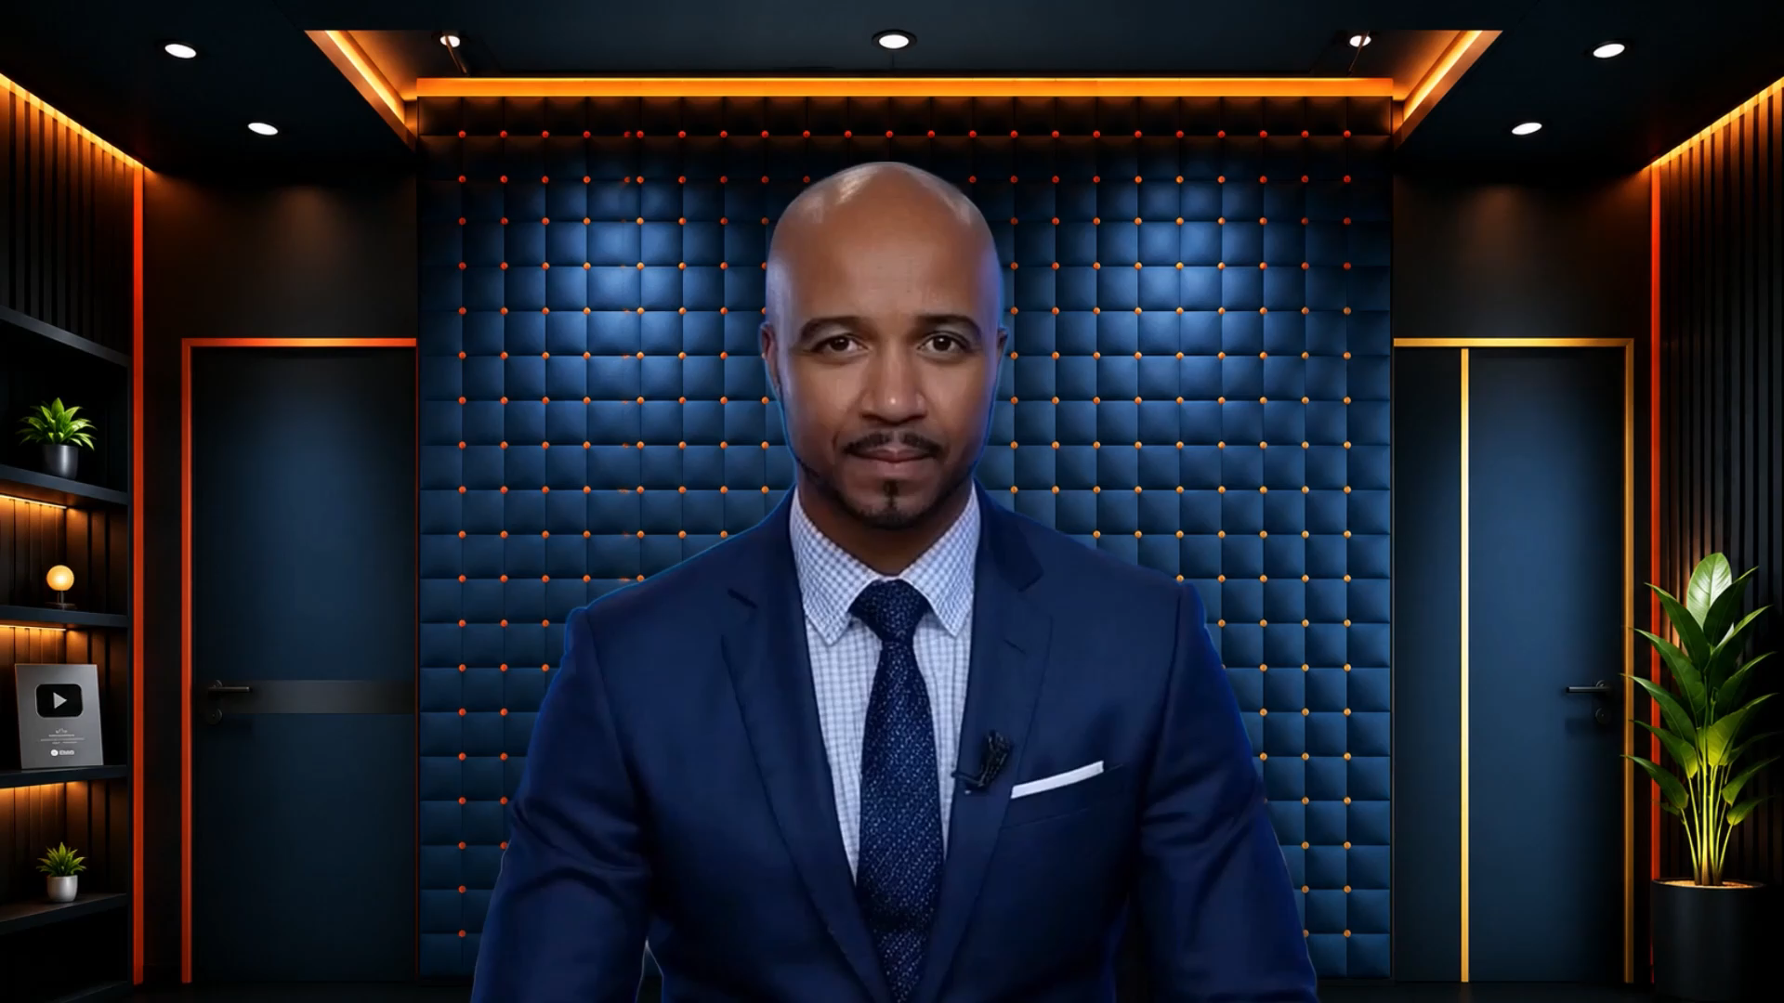

Slide 21

Strategy 3
HOW TO ORGANISE YOUR BUSINESS & PERSONAL
LIFE WITH AI
Use Projects Like Different Rooms
Create separate Projects for different areas
BUSINESS | Marketing • Branding • Planning
PERSONAL | Holidays • Family • Goals
Add relevant instructions, files & information
Keep the right context in the right place
Use Projects in ChatGPT + Claude
RIGHT ROOM. RIGHT CONTEXT. BETTER RESULTS.

Slide 22

CLICK THE PLAY BUTTON ON THE BOTTOM LEFT CORNER

Slide 23
Strategy 4
HOW TO GO BEYOND GOOGLE WITH DEEP RESEARCH
Don’t Just Search. Investigate.
Ask questions such as
What are the latest DVSA changes?
What are my competitors doing better than me?
How can I attract more customers in my area?
Simply tell AI:
“Use Deep Research to investigate…”
Then ask follow-up questions to go even deeper.
DEEP RESEARCH → ASK MORE QUESTIONS → BETTER INSIGHTS

Slide 24

Strategy 5
HOW TO IMPROVE THE CONTENT AI GIVES YOU
Don’t Accept the First Answer
Ask AI to:
Critique the answer
Identify what is weak or generic
Find what is missing
Challenge any assumptions
Make it significantly stronger
TRY THIS:
“Critique this x100. Be extremely critical. Now give me a much stronger version.”
FIRST ANSWER → CRITIQUE → BETTER ANSWER

Slide 25

Strategy 6
HOW TO GET AI TO INTERVIEW YOU
Let AI Ask the Questions
Instead of trying to explain everything yourself, say:
“Before answering, interview me.”
Ask me questions one at a time
Understand my situation and goals
Identify what information is missing
Challenge my assumptions
Then give me your best recommendations
BETTER QUESTIONS → BETTER CONTEXT → BETTER RESULTS

Slide 26
Strategy 7
HOW TO BUILD YOUR AI THINKING PARTNER
Capture Now. Develop Later.
Create 2 dedicated conversations
PERSONAL | Family • Holidays • Goals
BUSINESS | Marketing • Leads • Opportunities
Speak or type → AI adds the next number
When ready, AI can interview you to develop any idea
CAPTURE NOW → DEVELOP LATER

Slide 27
START YOUR IDEAS LIST
Copy This Prompt
“This is my [PERSONAL / BUSINESS] Ideas List.
Add every new idea as the next number.
Keep the list going. Don’t develop it unless I ask.
When I'm ready, interview me about any idea I choose.”
Create one PERSONAL list + one BUSINESS list

Slide 28

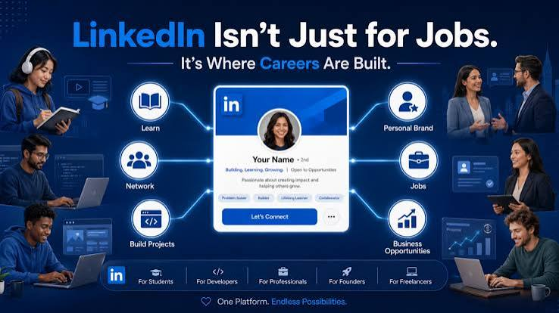
Strategy 8
HOW TO TURN AI & LINKEDIN INTO BUSINESS
OPPORTUNITIES
LinkedIn Isn’t Just for Jobs
Build your professional visibility
Reach parents, professionals & new audiences
Create content & images with AI
Promote driving lesson vouchers
Recruit ADIs & people to train as instructors
• ATTRACT CUSTOMERS • SELL VOUCHERS • RECRUIT INSTRUCTORS

Slide 29

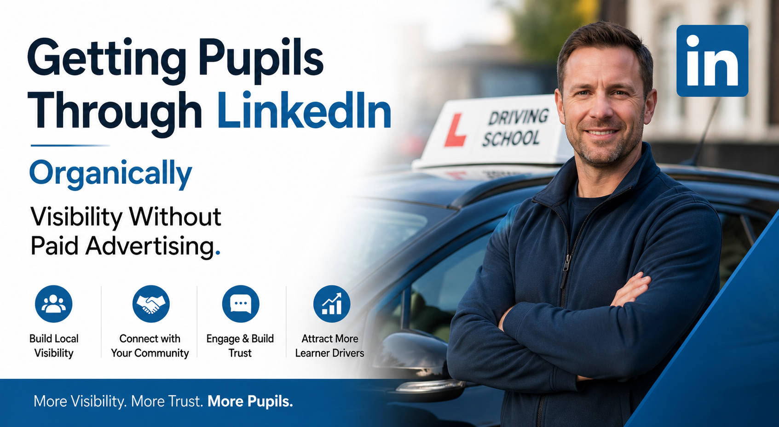

The One Place
Where Driving Instructors
Do Not Go
But Thousands of Opportunities Are.
AIForDrivingInstructors.com
Notes:
SLIDE 1
LINKEDIN ISN’T JUST FOR JOBS
Build your professional visibility
Reach parents, professionals & new audiences
Create content & images with AI
Promote driving lesson vouchers
Recruit ADIs & people to train as instructors
ATTRACT CUSTOMERS • SELL VOUCHERS • RECRUIT INSTRUCTORS
SLIDE 2
TURN VOUCHERS INTO YEAR-ROUND SALES
Create Seasonal Voucher Campaigns
🎂 Birthdays
🚗 “Just Turned 17”
🎄 Christmas
🐣 Easter
❤️ Valentine’s Day
🎉 Congratulations Gifts
🎓 Exam Pass Gifts
🎓 University Students
📚 Back-to-School Campaigns
CREATE WITH AI → PROMOTE → SELL ONLINE
LinkedIn + Facebook
MAKE SURE ONLINE PAYMENT IS ACTIVE
SEE IT → CLICK IT → BUY IT

Slide 30

TURN VOUCHERS INTO YEAR-ROUND SALES
Create Seasonal Voucher Campaigns
Birthdays
“Just Turned 17”
Christmas
Easter
Valentine’s Day
Congratulations Gifts
Exam Pass Gifts
University Students
Back-to-School Campaigns
CREATE WITH AI → PROMOTE → SELL ONLINE
LinkedIn + Facebook
MAKE SURE ONLINE PAYMENT IS ACTIVE

Slide 31
WHO WOULD LIKE A FREE COPY OF THESE SLIDES + A BONUS?
Scan the QR Code
on the reverse of your exercise sheet
Come and see me at my table
FREE SLIDES + BONUS RESOURCE

